Slide 1

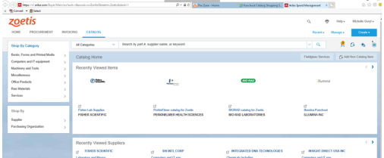
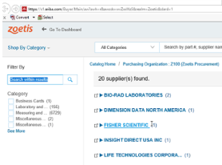
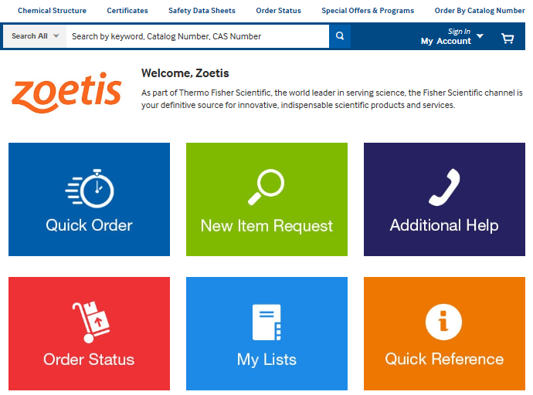


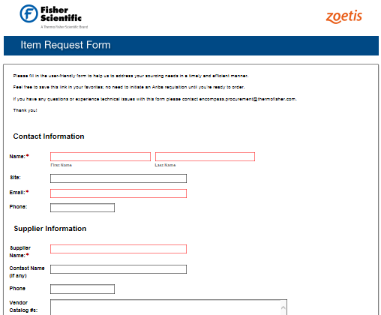

Quick Reference Ordering Guide
ORDER YOUR LAB SUPPLIES QUICKLY AND EFFICIENTLY
Need additional help?
Zoetis Customer Service
855-655-6434
Zoetis@thermofisher.com
Local team contacts:
See listing in Additional Help tile; also page 2 below
1) Access Zoetis Ariba dashboard
2) Select Fisher Scientific
3) Choose your product(s)
Don’t have a part number? Use Search!
Quick Tip:
fishersci.com has powerful SEARCH capabilities. Search by:
Description
Supplier part number
Fisher Scientific number
Competitor part number
CAS #
MDL #
Know your part number? Use Quick Order!
Still can’t find what you need? We will source it!
DIDN’T FIND WHAT YOU’RE LOOKING FOR?
Use the New Item Request Form
Third Party products are defined as products from suppliers who are not part of the typical distribution network in the scientific supplies commodity – suppliers who normally sell direct.
We offer over 800,000 Third Party products, representing over 7,000 suppliers, as a one-stop shop for the researcher. These products are indicated on fishersci.com by the Encompass icon.
New Item Requests:
Will be sourced in four business hours
Newly created items orderable via Quick Order
Searchable the following business day

Slide 2

Support Team Guide

